Slide 1
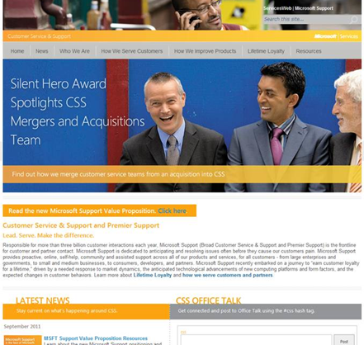
CSS Web Portal Development
The Challenge
The Microsoft Customer Service & Support portal implementation called for a robust publishing platform that site managers could use to make rich pages that adhered to branding, without requiring IT to author or maintain it.
What We Did
Affirma leveraged SharePoint features in an innovative way to achieve the core business goal of reducing IT cost. The resulting CSS Portal exceeded the client's expectations and created one of the strongest publishing user experiences within Microsoft.
Results
The updated CSS Web Portal is easy to navigate and maintain. This custom SharePoint Portal allows for complete autonomy of user managed content with adherence to brand and style guide standards.

